Slide 1

Abstractions
Lecturer
Rokas Slaboševičius
Data

Slide 2
Today you will learn
Abstractions
Abstract classes
Using abstract classes in simple classes
01
04
Abstract fields
02
Inheritance of abstract classes
03

Slide 3
What is abstraction?
Abstractions
Abstraction is a CS (computer science) process in which only the "necessary" data is displayed, while the unnecessary details of an object are hidden from the user.
Take your mobile phone for example, you just need to know which buttons to press to send a message, take a photo or make a call. What happens when you press the button, how your messages are sent, how your phone connects to the network - all these details are hidden from the user, they are an abstraction.

Slide 4
What is abstraction?
Abstractions
In C# programming, an abstraction is used to create a "blueprint" of a class for other classes. This is achieved by using "abstract" classes and "interfaces".
The Abstract class is a special class that cannot be initialized. Therefore, you cannot create an object of the abstract class. It acts as a blueprint for other classes. An abstract class can have both abstract (unimplemented) and concrete (implemented) methods. Abstract methods are those that are declared but not implemented in the abstract class. Concrete classes that inherit an abstract class must implement abstract methods.
Interface - learning for the future

Slide 5
Abstract class
Abstractions
The first "blueprint" we will create is an abstract class for different animal species.
What needs to be understood is that the abstract class will be inherited by the standard classes and the abstract class must have properties that are common to all the classes that will inherit it.
For example: if we want to create an abstract class Animal, which will be inherited by different animal classes like Cat or Dog, we need to think about what properties cats and dogs have in common, and then what properties are unique to those classes.
The first property that is common is that both dogs and cats have the same weight measurements, so we can put the Weight property in the abstract class Animal.

Slide 6
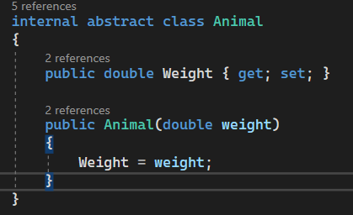
Animal class
Abstractions
The first version of the class will look like this:
Weight property which will be held by all hereditary classes and
constructor which will initialize the Weight property

Slide 7
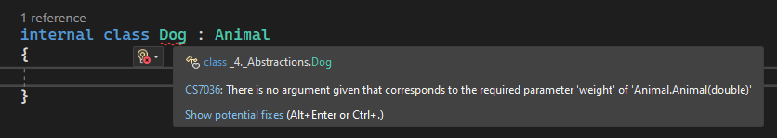
Animal class
Abstractions
When we create a dog class and inherit the Animal class, we immediately get an error:
This bug says that we must implement everything that is marked abstract in the Animal class and the constructor

Slide 8
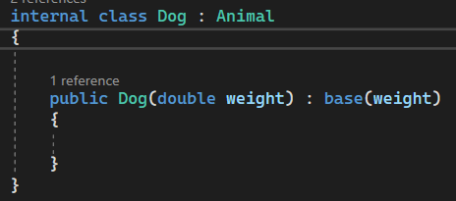
Animal class
Abstractions
This creates the Dog class constructor:

Slide 9
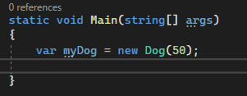
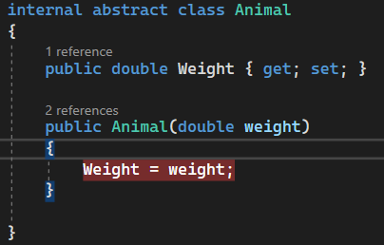
Animal class
Abstractions
Let's see how the constructor works, by putting a breakpoint in the constructor of the Animal class and creating an object of the Dog class, we run the program

Slide 10
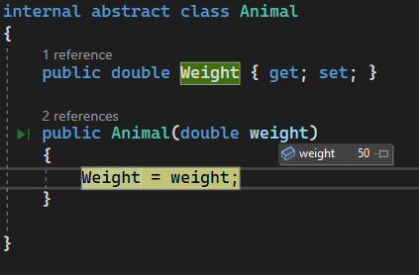
Animal class
Abstractions
When we run the program, we can see that the program entered the constructor in the Animal class with the weight value passed in the Dog class constructor.

Slide 11
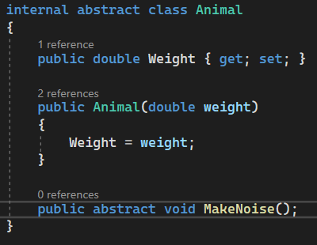
Animal class - abstract method
Abstractions
Let's look at how abstract methods are used.
Let's create an abstract MakeNoise() method in the Animal class.
As you can see - abstract methods don't have a "body", they only have a method declarations.
MakeNoise - its implementation must take care of
the classes that inherit from it, in this case the single class Dog.

Slide 12
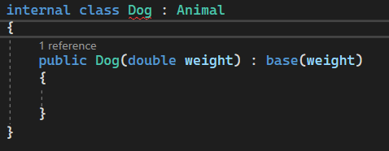
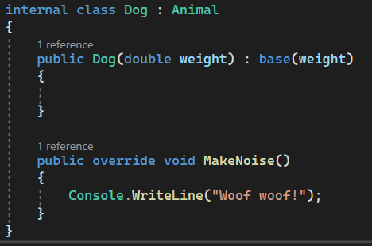
Animal class - abstract method
Abstractions
As you can see, the Dog class immediately reports an error, this error is because,
that the MakeNoise method is not overridden, the bugs that made that
we won't see it again.
Repetition:
Both abstract properties and methods must be implemented in child classes

Slide 13
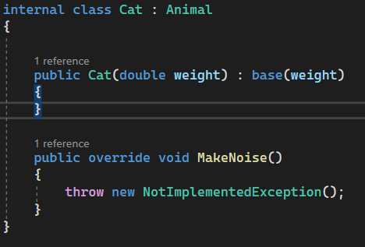
Cat class
Abstractions
Let's create a second child class Cat, inherit from animal and implement it

Slide 14
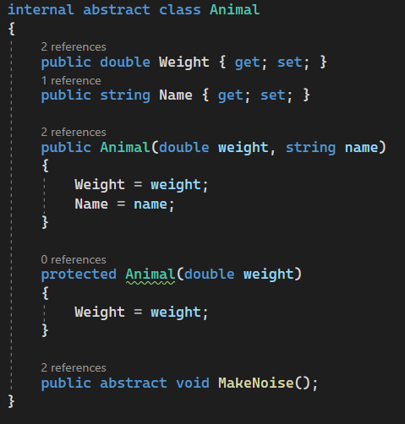
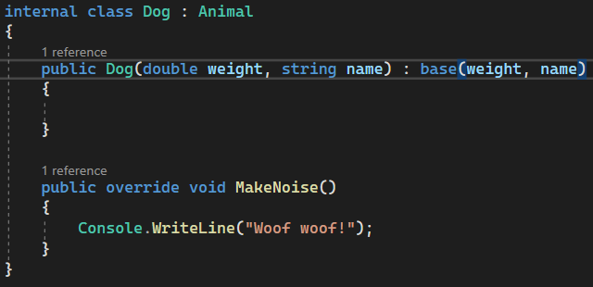
Name field
Abstractions
For a more realistic scenario, let's add the abstract field Name to the Animal class and add it to the Animal constructor.
Note that if you change the constructor of the parent class, you have to add parameters to the constructor of the child classes and pass them to base() as well.

Slide 15
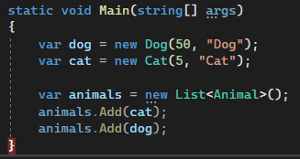
List<Animal>
Abstractions
One way to see the "beauty" of abstractions is to create a list specifying the data type of the parent class, but putting the child class objects inside.
At first glance, this may seem strange: we have specified a completely different data type than the one we were adding the objects to.
When we created the list, we specified the Animal data type, but put the Dog and Cat objects inside.
This is called polymorphism, and this is one of the first examples of it, which we will go into more in the future.

Slide 16
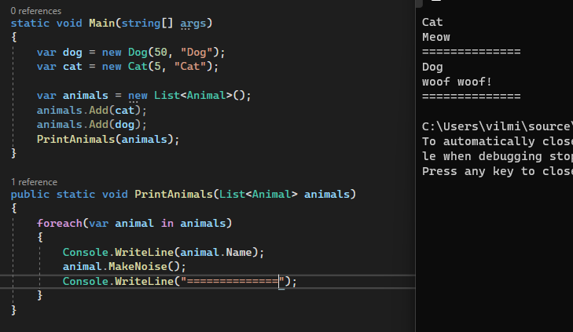
List<Animal>
Abstractions
We can also pass this list to a method.
By iterating through the Animals type list, we can
to reach all child objects in Name property so,
because when we create a children's class we must use this field implement.
For the same reason, we can call for a method
MakeNoise.

Slide 17
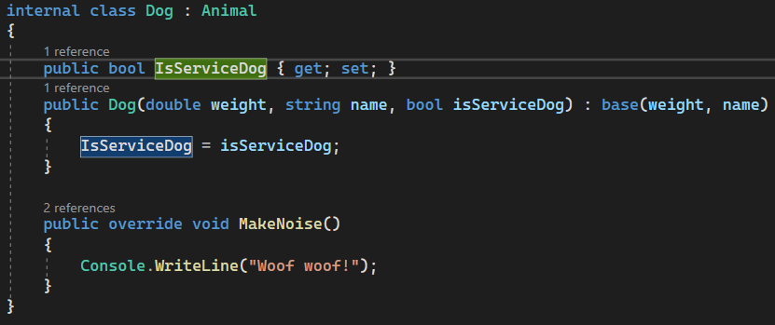
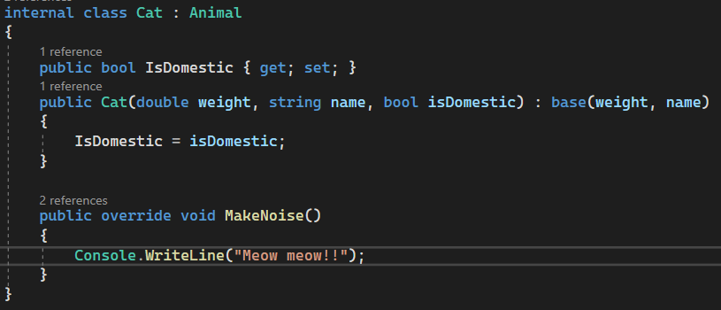
Cat and Dog
Abstractions
Worth noting:
Child classes can have their own unique Properties, they don't have to be just overridden fields/methods inherited from the parent class.
As you can see here, both Dog and Cat classes have a Property unique to their class. Notice how the constructor looks

Slide 18

Abstractions
Task 1
Create an abstract class GeometricShape with abstract methods GetArea() to calculate the area and GetPerimeter() to calculate the perimeter. Create Triangle and Square classes inheriting GeometricShape and override methods.
Create an abstract class Animal with an abstract method MakeNoise(), create classes Dog and Cat which will inherit Animal and implement methods.
Create a list from the GeometricShape data type, add objects of the Triangle and Square classes to this list and iteratively print the perimeters and areas of these classes.
Create

Slide 19
Abstractions
Task 2
Create an abstract class Vehicle and think about what features are common to all vehicles? Create several different vehicle classes such as Bus, Truck, Scooter. Think about what features are unique to these vehicles and implement them.
Create a Human class and assign it a list of Vechicle classes, create a method that will allow any vehicle to be assigned to this class.
Make the Human class abstract, create several different human type classes inheriting the Human class and add lists for vehicles.

